Slide 1

Accessibility Analysis
Washington D.C.
A method to efficiently manage
city infrastructure
Presented by: CHRIS WOODARD Date: 11/10/17
Research team: Claire Chu
Nathan Mowat
Bill Kerneckel
Chris Woodard
Advisor: Dr. Eric Larson

Slide 2
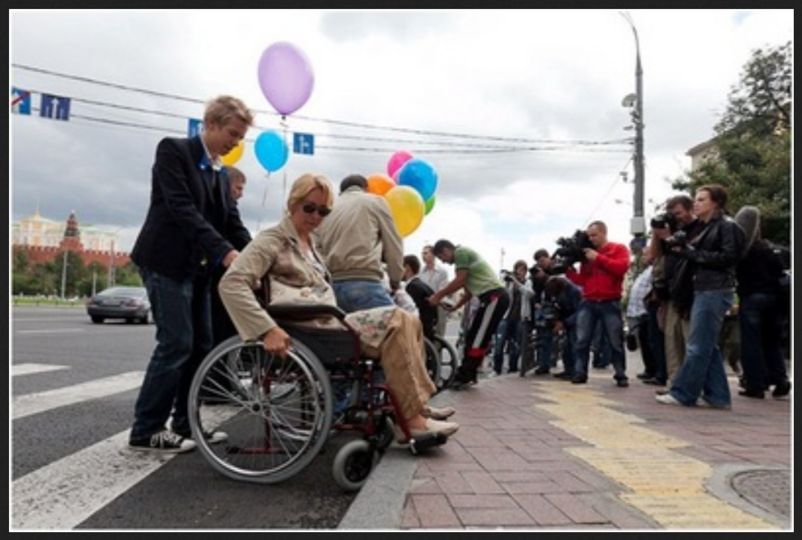
iNTRODUCTION:
sIDEWALK aCCESSIBILITY
Notes:
Sidewalk accessibility :
- sample story of intern in DC
- photo of mobility protest in Moscow
-lack of wheel chair ramps from the sidewalk at crosswalks so difficulties of travelling in wheelchair

Slide 3
PREDICTABLE ACCESSIBILITY
CRIME DATA
PREDICTABLE
ACCESSIBILITY
REAL ESTATE DATA
“PROJECT SIDEWALK”

Slide 4
ACCESSIBLITY FACTS ABOUT D.C.
"In 2014, there was $27 Million of backlog for sidewalk repairs"
Total # of Service Requests:
2013: 158,637
2014: 140,050
2015: 137,034
Cost of one PCC Wheelchair/Bike Ramp $1000

Slide 5
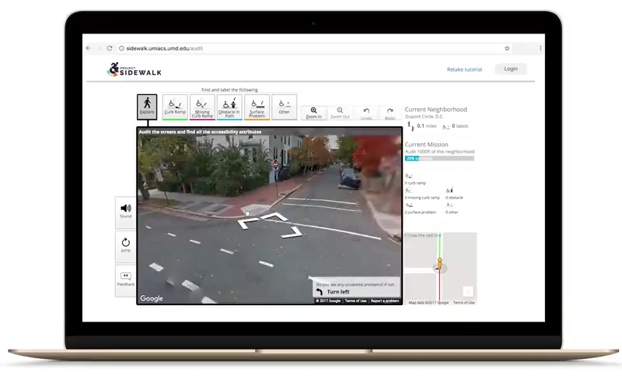
“PROJECT SIDEWALK”
“Project Sidewalk” was created by a team of students from the Human-Computer Interaction Lab at the University of Maryland lead by Dr. Jon Froehlich.
Goals of “Project Sidewalk”
Mobility oriented
Sidewalk labeling
Source: https://sidewalk.umiacs.umd.edu/
Notes:
“Project Sidewalk” was created by team of students from the Human-Computer Interaction Lab at the University of Maryland lead by Dr. Jon Froehlich.
Never been an organized or well maintained data for impaired walkers to plan their travel routes.
Designed to establish a live mapping database for wheelchair and mobile scooter users.
This is how they established which labels were important
Initially all labelling done by wheelchair/scooter users, now completed with help of paid “amazon turks” and end users
At the time of collection 80% of all sidewalks were labeled

Slide 6
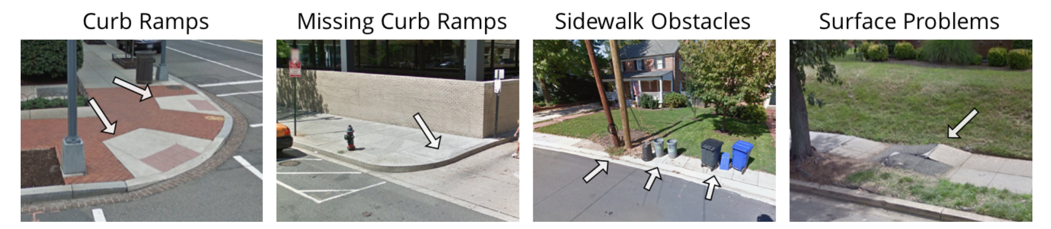
Why “Project Sidewalk” data is important
Repurpose data to tell a story about sidewalk repair in Washington D.C.
Use label data to predict problem sidewalk areas
Label data consists of:
Curb Ramps, Missing Curb Ramps, Sidewalk Obstacles, Surface Problems
80% of the sidewalks of Washington D.C. were labeled at start of this project. As of today, 100% of the sidewalks are labeled.
Notes:
“Project Sidewalk” was created by team of students from the Human-Computer Interaction Lab at the University of Maryland lead by Dr. Jon Froehlich.
Never been an organized or well maintained data for impaired walkers to plan their travel routes.
Designed to establish a live mapping database for wheelchair and mobile scooter users.
This is how they established which labels were important
Initially all labelling done by wheelchair/scooter users, now completed with help of paid “amazon turks” and end users
At the time of collection 80% of all sidewalks were labeled

Slide 7
CURRENT ISSUES
"Scheduled Sidewalk Response Time: investigation 1-10 business days, temporary (emergency) repairs: up to 15 business days, permanent resolution depends on investigation, permanent repairs require longer timeframe and depend on funding availability”
FISCAL YEAR 2016 TOTAL APPROVED OPERATING BUDGET: $113,676,337
Civil services may not be exclusionary to persons with disabilities as stated in Title II of the American Disabilities Act.
Notes:
Now we have this data….can we get more out of it? What if we can find correlations with this data to help facilitate the metro area more accessible?
Title II of the ADA requires State and local governments to make their programs and services accessible to persons with disabilities.

Slide 8
PROBLEM STATEMENT
Washington D.C. has allocated a yearly budget for city repairs.
There is a backlog of repairs and the city has a hard time prioritizing what repairs are more important than others.
Using the crowdsource labeling data, City crime data, and real-estate market pricing data we can predict results that are better than chance what areas will have problematic sidewalks.
Notes:
Now we have this data….can we get more out of it? What if we can find correlations with this data to help facilitate the metro area more accessible?

Slide 9
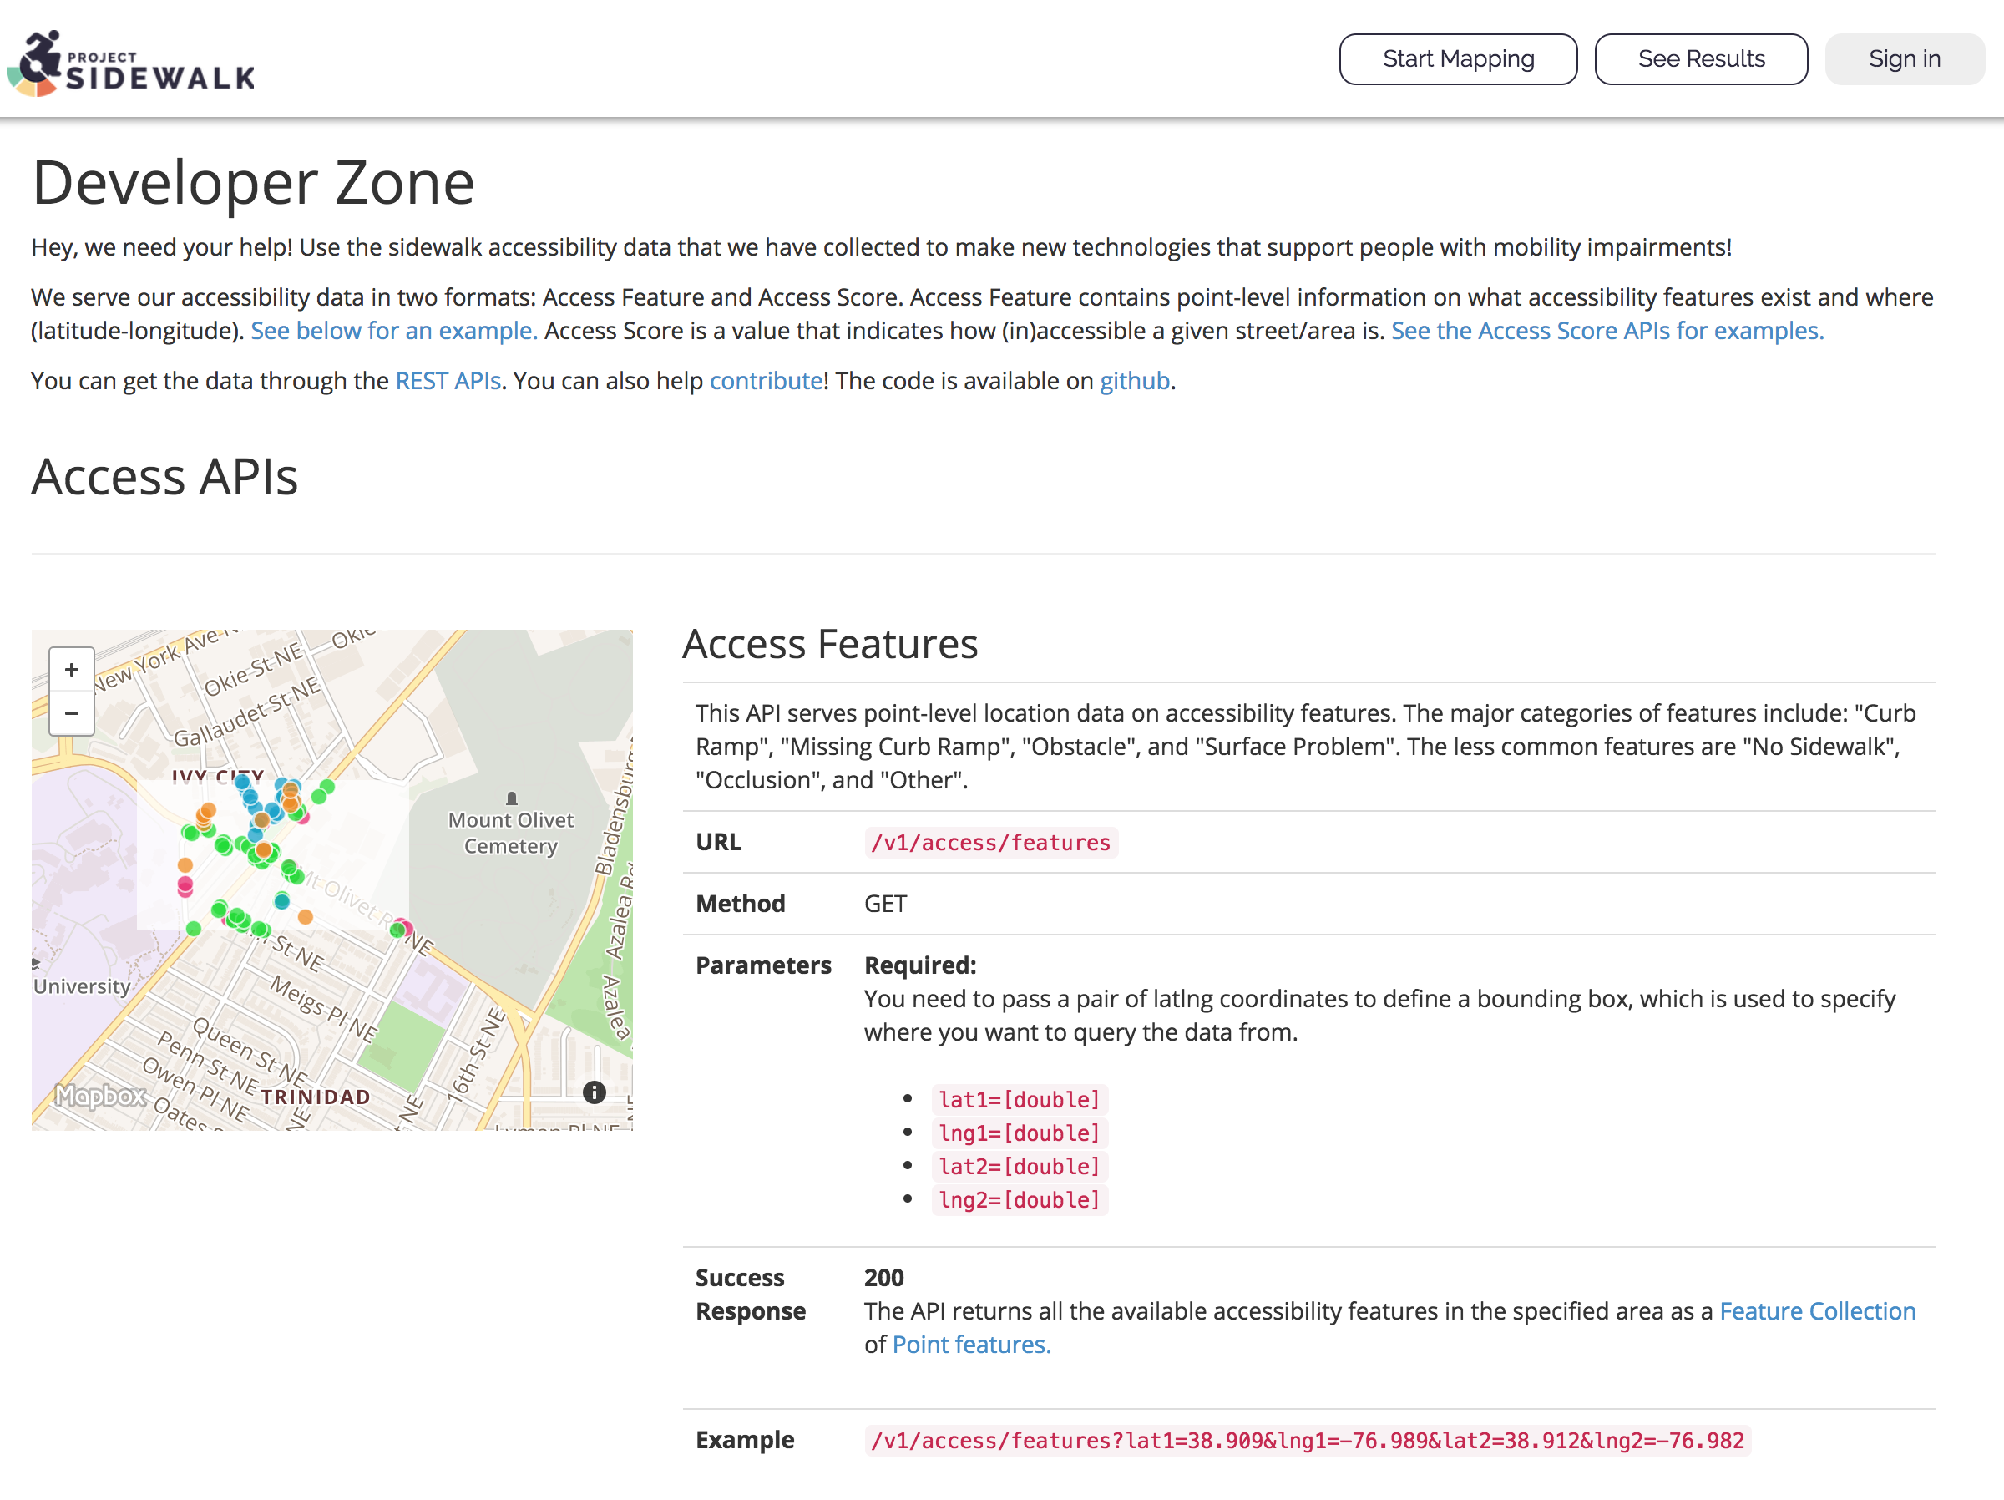
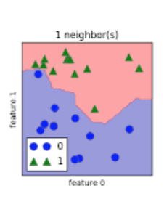
APPROACH
1
2
3
4
Consume API, Zillow, Crime Data
Used R & Python to transform json data
Google API
Used R & Python to model the data
Notes:
Got data from Zillow, Crime D.C., Project Sidewalk
Used Industry standards such a R and Google API
Model the data

Slide 10
REAL ESTATE ANALYSIS
KNN
Random Forest
Logistic Regression
Support Vector Machine
Model Accuracy
Notes:
Bar chart models each sidewalk label, sorted by model accuracy.
[[ CURB RAMP ]] SVM 0.4375 KNN 0.573770492 Log. Reg 0.625 R. Forest Train 0.672131148
[[ NO CURB RAMP ]] KNN 0.606557377 Log. Reg 0.625 R. Forest Train (10) 0.672131148 SVM 0.75
[[ OBSTACLES ]] KNN 0.409836066 R. Forest Train(10) 0.508196721 SVM 0.5625 Log. Reg 0.6875
[[ SURFACE PROBLEM ]] KNN 0.524590164 Log. Reg 0.5625 SVM 0.5625 R. Forest Train(10) 0.62295082
Decided to move forward with Random Forest modeling

Slide 11
REAL ESTATE RESULTS
Random Forest Modeling
The “Curb Ramp” & “No Curb Ramp” label
Notes:
Utilized grid structure to look at the GRANULARITY of the sidewalk data
Each sidewalk label is lat/long, convert to this grid to better group the crime data organized block/block

Slide 12
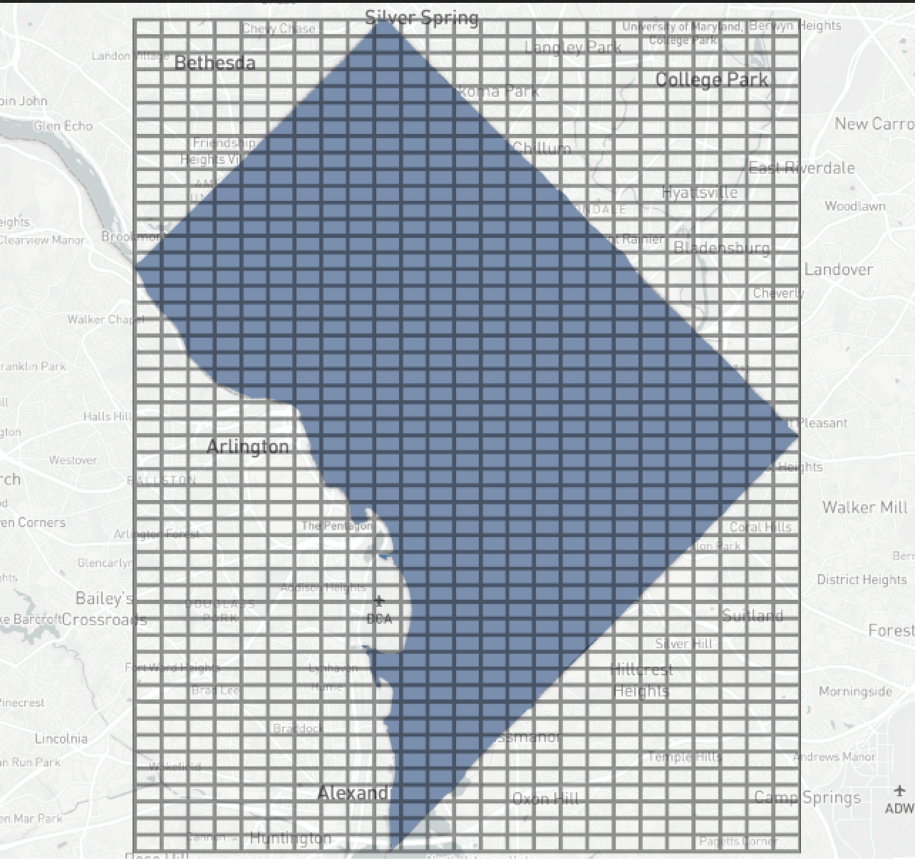
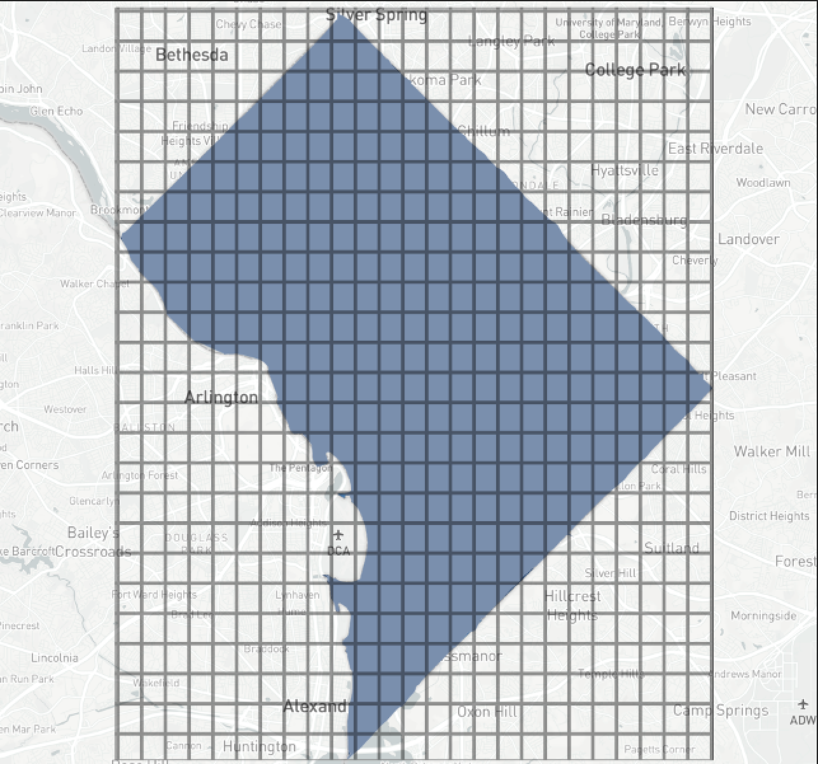
CRIME DATA ANALYSIS
50 x 50 grid
25 x 25 grid
Notes:
Utilized grid structure to look at the GRANULARITY of the sidewalk data
Each sidewalk label is lat/long, convert to this grid to better group the crime data organized block/block

Slide 13
RESULTS: ACCURACY
Notes:
RESULTS:
CURB RAMP & NO CURB RAMP WERE MOST ACCURATE AGAIN
LABEL // ACCURACY
CurbRamp // 50x50 : 95.76, 25x25 : 97.12
NoCurbRamp // 50x50 : 93.24, 25x25 : 96.64
Obstacle // 50x50 : 91.24, 25x25 : 96.52
SurfaceProblem // 50x50 : 90.92, 25x25 : 95.04
NoSidewalk // 50x50 : 88, 25x25 : 93.44
Occlusion // 50x50 : 79.72, 25x25 : 85.28

Slide 14
RESULTS: IMPORTANCES 50 x 50
50 x 50 GRID IMPORTANCES
 | CurbRamp | NoCurbRamp
Day | 20.2157 | 18.966
Evening | 20.1284 | 22.0359
Midnight | 16.7111 | 19.6912
Vehicle Theft | 14.0855 | 14.8024
Robbery | 8.7081 | 8.2786
Burglary | 14.6126 | 15.1431
Homicide | 1.6606 | 0.1926
Sex abuse | 3.8776 | 0.8899
Arson | 0 | 0
Notes:
Day was the most important for Curb Ramp
Evening was the most important for No Curb Ramp
-----WHY??------
The “SHIFT” metric had to be recorded for EVERY entry. So there is plenty of data for “day”, “evening”, “night” vs. “arson” which only had, a few reported cases
If you look between the two importance, vehicle theft and robbery are a close second
Amount of IMPACT on each column (sidewalk label)

Slide 15
RESULTS: IMPORTANCES 25 x 25
25 x 25 GRID IMPORTANCES
 | CurbRamp | NoCurbRamp
Day | 20.3762 | 18.4981
Evening | 19.6574 | 20.8991
Midnight | 12.0401 | 14.0016
Vehicle Theft | 15.6729 | 14.6189
Robbery | 13.6176 | 12.3292
Burglary | 10.0019 | 11.7326
Homicide | 2.2007 | 1.6579
Sex abuse | 6.3536 | 6.2238
Arson | 0.0793 | 0.03837
Notes:
Day was the most important for Curb Ramp
Evening was the most important for No Curb Ramp
-----WHY??------
The “SHIFT” metric had to be recorded for EVERY entry. So there is plenty of data for “day”, “evening”, “night” vs. “arson” which only had, a few reported cases
If you look between the two importance, vehicle theft and robbery are a close second
Amount of IMPACT on each column (sidewalk label)

Slide 16
CRIME STATUS RESULTS
25 x 25 grid had better accuracy
“Curb Ramp” & “No Curb Ramp”
Notes:
REGIONALITY:
-better results for 25x25
-makes sense since even though sidewalk data is granular, crime data is by block
-also holds true for the real estate data, neighborhood by neighborhood
-also good for how they logistically plan repairs

Slide 17
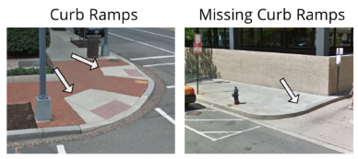

WHAT DOES THIS ALL MEAN?
REGIONALITY
SIDEWALK LABEL
LOGISTICS
25 x 25 results
Granularity of crime/housing
Curb Ramp
No Curb Ramp
Sidewalk repair is regionalized, not granular
Notes:
REGIONALITY:
-better results for 25x25
-makes sense since even though sidewalk data is granular, crime data is by block
-also holds true for the real estate data, neighborhood by neighborhood
-also good for how they logistically plan repairs
CW: 12 SECOND READ
“We used housing prices and crime statistics to predict the location of sidewalk infrastructure problems. The results were significant for the Curb Ramp and No Curb Ramp variables.”

Slide 18
PREDICTABLE ACCESSIBILITY
CRIME DATA
PREDICTABLE
ACCESSIBILITY
REAL ESTATE DATA
“PROJECT SIDEWALK”

Slide 19
CONCLUSION
Using random forest analysis on the Washington D.C. crime statistics and real estate data, we uncovered a predictive relationship for sidewalk accessibility that is better than random chance. With the methods we outline here, Washington D.C. will be better able to anticipate sidewalk repairs and better allocate resources to minimize these large backlogs.

Slide 20
MOVING FORWARD
Increased sidewalk repair efficiencies
Better budget forecasting
1
Prioritization of predicted problem areas
2
3
+
Improve accessibility
Potential expansion for new customer base for businesses

Slide 21
FUTURE WORK
Pedestrian traffic data incorporated with our findings to better analyze priority sidewalks.
Sidewalks around schools
Sidewalks near senior citizens
Sidewalks near public transportation

